Slide 1

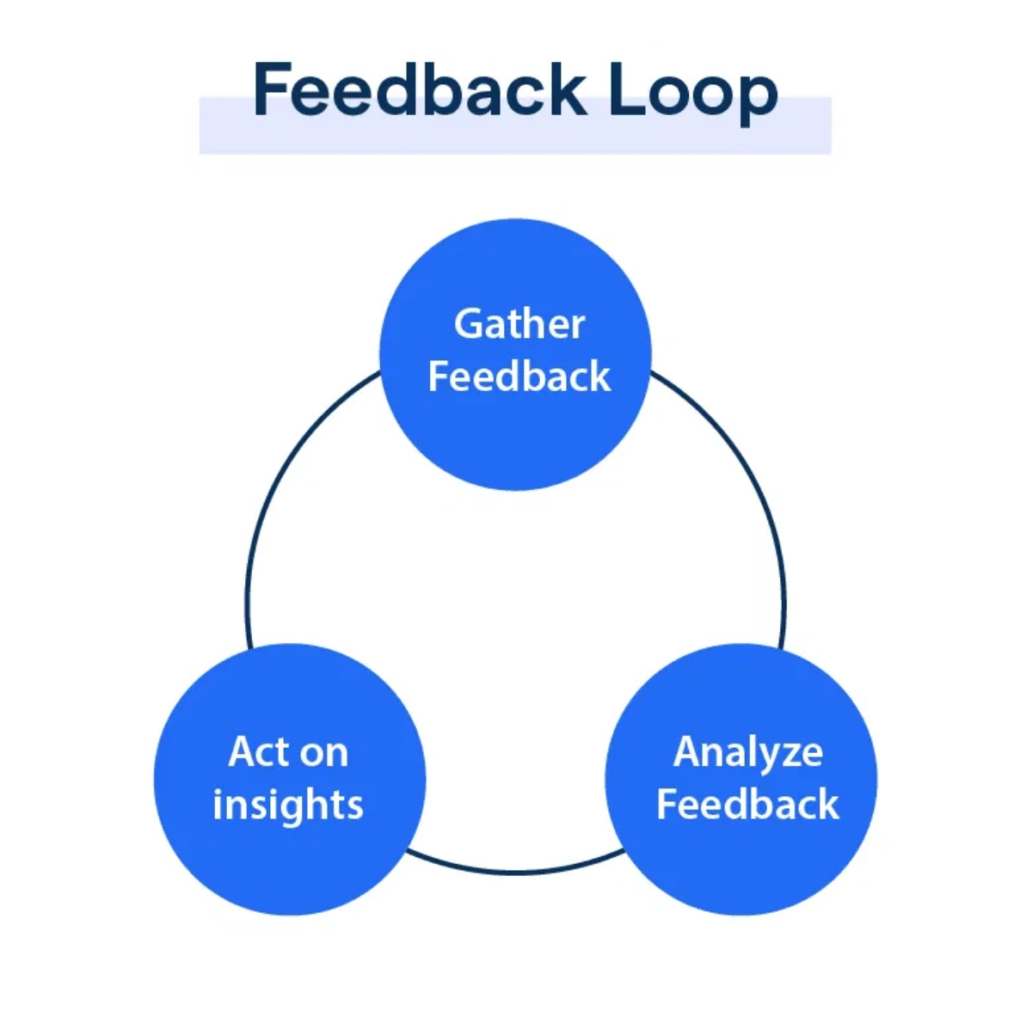
Continuous Learning Agent
(CLA)
A Core Component of the
AI-Driven SOC System
Enabling ML Models to Improve Through Feedback

Slide 2

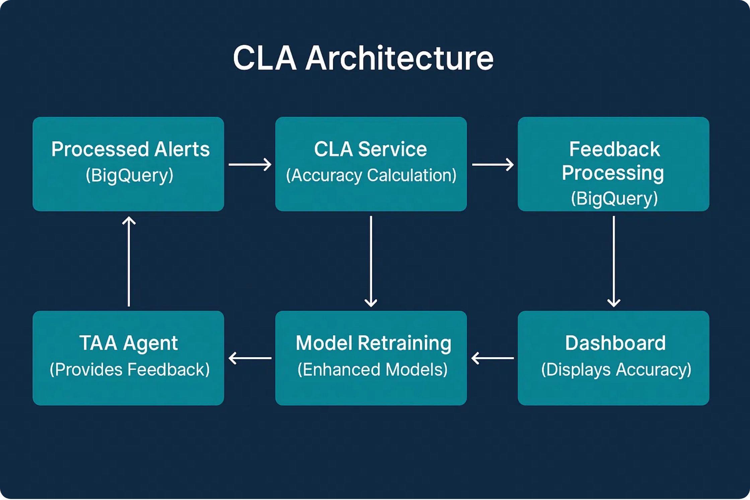
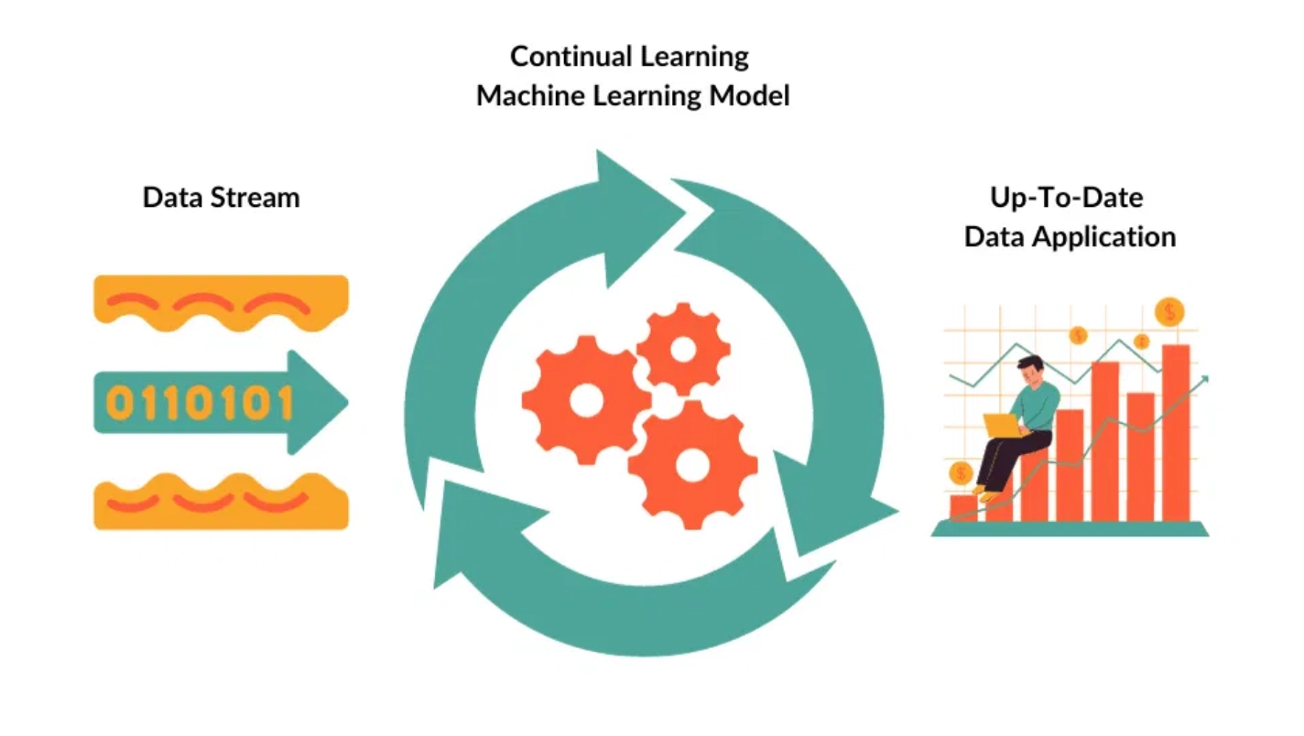
System Overview & Architecture
Core Components
Feedback Ingestion:
Collects analyst feedback on alert classifications
Accuracy Calculation:
Compares model predictions with analyst feedback
Model Retraining:
Updates ML models based on accuracy metrics
Performance Monitoring:
Tracks accuracy improvements over time
Integration Points
ADA:
Shares alert data via BigQuery tables
TAA:
Exchanges feedback via Pub/Sub messaging
Dashboard:
Provides metrics via REST API endpoints

Slide 3

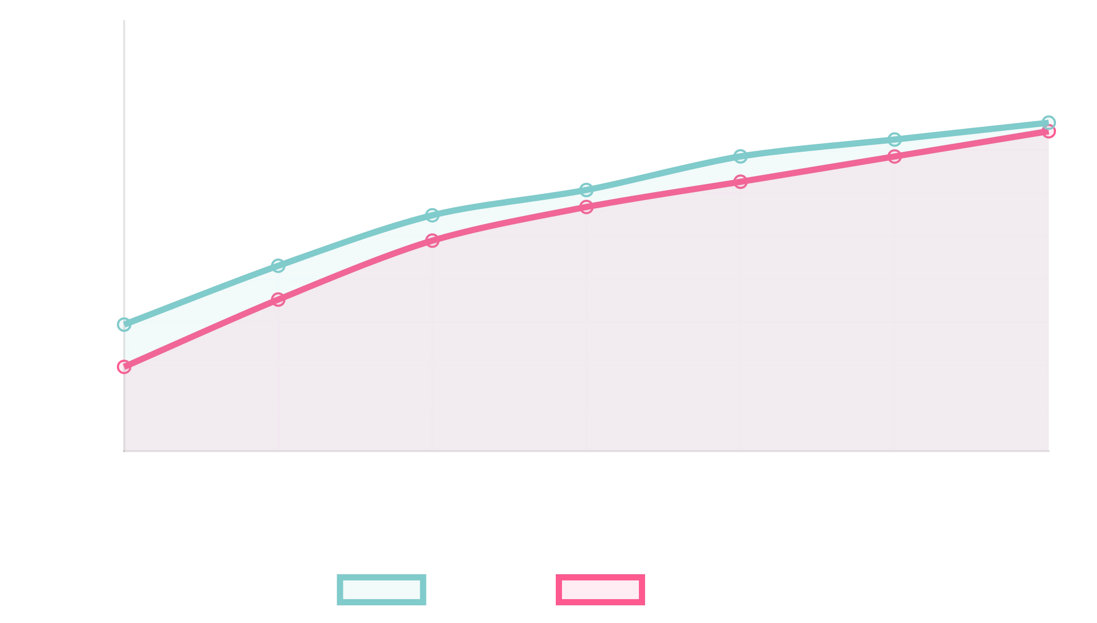
Key Features & Benefits
Accuracy Metrics
Performance Monitoring
Overall Accuracy:
Total correct predictions / total predictions
Precision:
True positives / (true positives + false positives)
Recall:
True positives / (true positives + false negatives)
F1 Score:
Harmonic mean of precision and recall
Future Enhancements
Automated Retraining:
Based on accuracy thresholds
Multi-model Support:
Sample visualization of accuracy metrics over time
Ensemble models and A/B testing
Real-time Learning:
Immediate model updates
Business Impact
Explainable AI:
Detailed reasoning for predictions
Reduced false positives through continuous improvement
Enhanced threat detection capabilities
Improved analyst efficiency and productivity
Measurable ROI through adaptive AI systems

